Slide 1
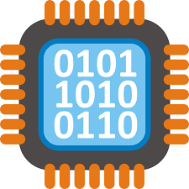
Introduction
Computer Organization

Slide 2

About me
IBM
Adjunct Lecturer at Lehman
Tech Community Organizer
Entrepreneur
Back to Lehman 😀

Slide 3


1. Intro
Why computer organization?
Level of Transformation
Moore’s Law
Computer Revolution
Classes of computer applications
Understanding Performance
The power of abstraction

Slide 4
Computer Organization help us understand how exactly each instruction is executed at the micro level.
Notes:
Why is it important to study computer organization and architecture?
Computer Organization and Architecture lets you know how exactly each instruction is executed at the micro level. The data flow, timing analysis, memory hierarchy, trade offs between execution cycles, hardware requirements/costs, software-hardware trade-offs can be known.

Slide 5
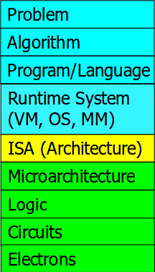
Computer Architecture
Levels of Transformation
Notes:
Why should we worry about knowing it?
If you master both hardware and software (and the interface between them):
1) Can develop better software if you understand the hardware
2) Can design better hardware if you know the software
3) Can create a better computing system if you understand both

Slide 6
Why should we care about Moore’s Law!
Notes:
Why should we worry about knowing it?
If you master both hardware and software (and the interface between them):
1) Can develop better software if you understand the hardware
2) Can design better hardware if you know the software
3) Can create a better computing system if you understand both

Slide 7
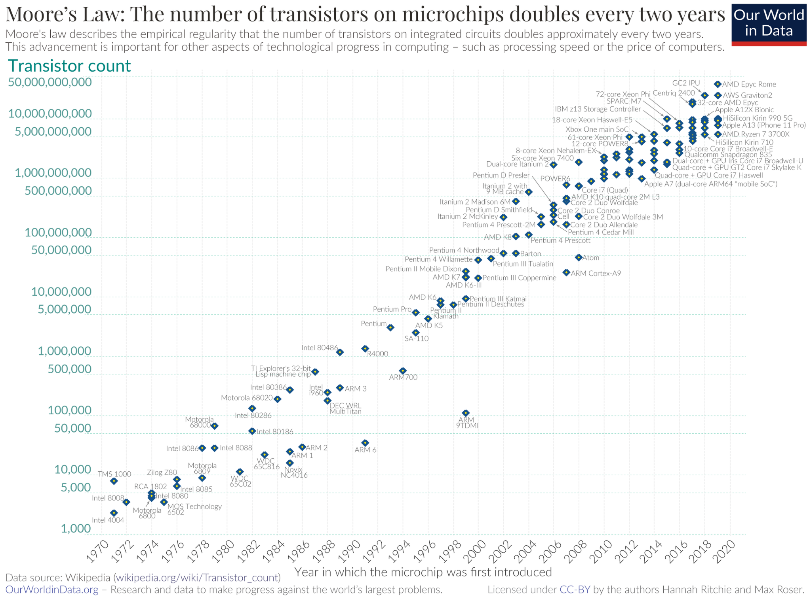
Notes:
What Is Moore's Law? Moore's Law refers to Moore's perception that the number of transistors on a microchip doubles every two years, though the cost of computers is halved. Moore's Law states that we can expect the speed and capability of our computers to increase every couple of years, and we will pay less for them.
What are the three 3 things that make Moore's Law?
If electronics now travel half the distance to make a calculation, that means the chip is twice as fast. But the shrinking can't go on forever, and we're already starting to see three interrelated forces—size, heat, and power—threatening to slow down the Moore's Law gravy train.

Slide 8
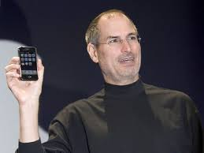
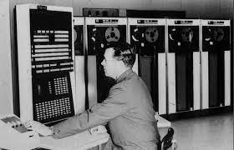
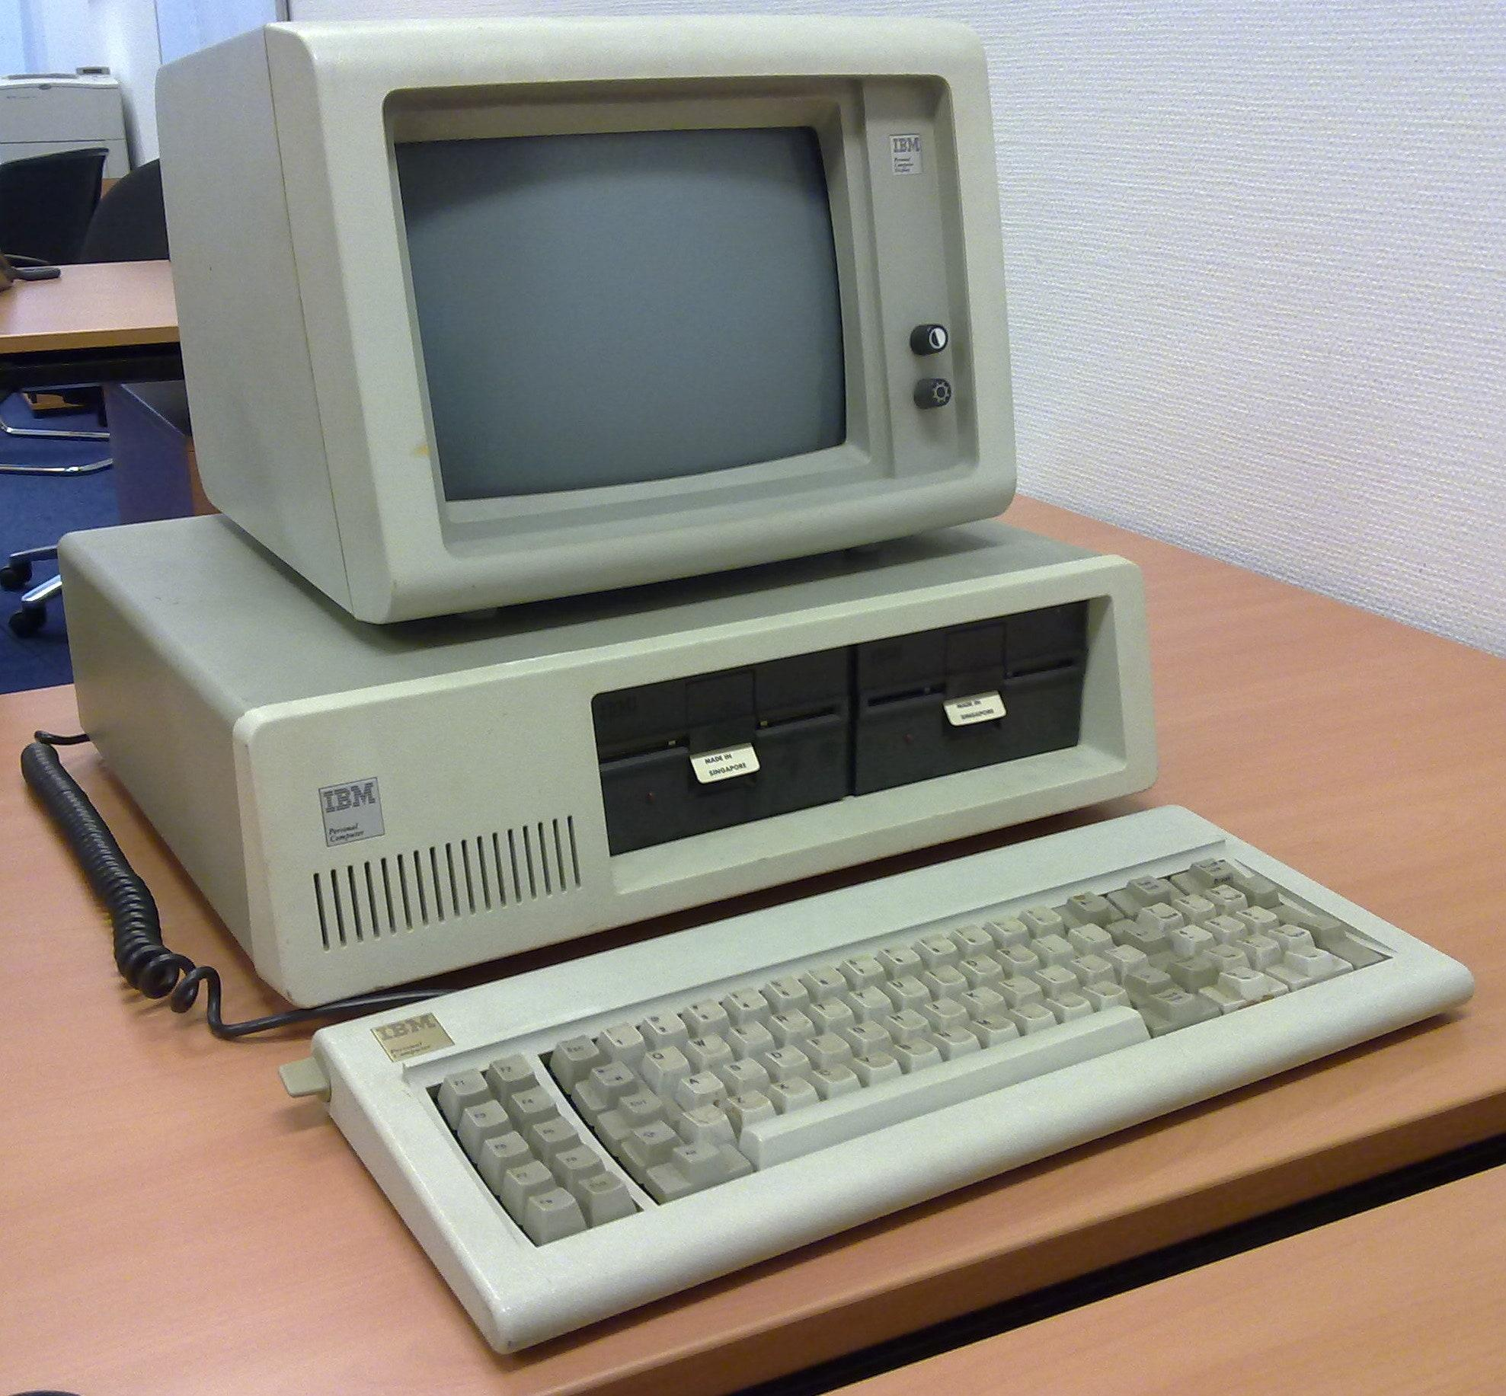

Computer Revolution
Notes:
Before 1970, computers were big machines requiring thousands of separate transistors. They were operated by specialized technicians, who often dressed in white lab coats and were commonly referred to as a computer priesthood. The machines were expensive and difficult to use. Few people came in direct contact with them, not even their programmers. The typical interaction was as follows: a programmer coded instructions and data on preformatted paper, a keypunch operator transferred the data onto punch cards, a computer operator fed the cards into a card reader, and the computer executed the instructions or stored the cards’ information for later processing. Advanced installations might allow users limited interaction with the computer more directly, but still remotely, via time-sharing through the use of cathode-ray tube terminals or teletype machines.
At the beginning of the 1970s there were essentially two types of computers. There were room-sized mainframes, costing hundreds of thousands of dollars, that were built one at a time by companies such as IBM and CDC. There also were smaller, cheaper, mass-produced minicomputers, costing tens of thousands of dollars, that were built by a handful of companies, such as Digital Equipment Corporation and Hewlett-Packard Company, for scientific laboratories and businesses.
Still, most people had no direct contact with either type of computer, and the machines were popularly viewed as impersonal giant brains that threatened to eliminate jobs through automation. The idea that anyone would have his or her own desktop computer was generally regarded as far-fetched. Nevertheless, with advances in integrated circuit technology, the necessary building blocks for desktop computing began to emerge in the early 1970s.

Slide 9
Notes:
I learned to code on this machine

Slide 10
Computer Applications build for different hardware:
Desktop
Mobile
Embedded Devices
Servers
Super Computers
Notes:
Applications build for different class of hardware
A desktop application is a software program that can be run on a standalone computer to perform a specific task by an end-user
A mobile application, most commonly known as an app, is a kind of application software intended to run on a mobile phone, for example, a smartphone or tablet PC
Embedded software is computer software, written to control machines or devices that are not typically thought of as computers, commonly known as embedded systems. It is typically specialized for the particular hardware that it runs on and has time and memory constraints.[1] This term is sometimes used interchangeably with firmware.[2]
A "server application" is an application that waits for requests from other applications and responds to them, thus providing a "service" upon their request. A web server is a server application.
Most commonly supercomputers are used for Particle Simulation, Molecular Analysis, Other Complex Scientific and/or Mathematical models, Brute Force Cryptography, large scale data analysis and ray-tracing based rendering.
Of course there are plenty of other tasks they are used for.

Slide 11

Understanding Performance

Slide 12
Algorithm
Programming Language, compiler and architecture
Processor and memory system
I/O system (HW & OS)
Notes:
Algorithm - determines both the number of source-level statements and the number of I/O operations executed
Programming Language, compiler and architecture - determines the number of computer instructions for each source-level statement
Processor and memory system - determines how fast instructions can be executed
I/O system (HW & OS) - determines how fast I/O operations may be executed

Slide 13

Power of Abstraction

Slide 14
Levels of transformation create abstractions
Notes:
Abstraction is when a higher level only needs to know about the interface to the lower level, not how the lower level is implemented
Example, high-level language programmer does not really need to know what the ISA is and how a computer executes instructions

Slide 15
Abstraction improves productivity
Notes:
No need to worry about decisions made in the underlying levels
Example, programming in Java vs. C vs. Assembly vs. Binary vs. by specifying control signals of each transistor every cycle
If you do not need to worry about decisions made in the underlying or levels above, why would you want to know what goes on in them?

Slide 16
2. End
Collaborate on Slack
Share a real life example of abstraction.
Watch How Computer Works
Download Logisim-evolution
Test that you are able to run on your computer.

